Slide 1

Monthly Performance Report – May 2026
CAMPUS

Slide 2

Table of Contents
Title | Page Number
B.C.A – II Year | 5
Overall Attendance | 6
Technical Evaluation | 7
Overall Communication Level | 9
Academic performance | 10
B.C.A – I Year Batch | 11
Overall Attendance | 12
Technical Evaluation | 13
Overall Communication Level | 15
Academic performance | 16

Slide 3
Table of Contents
Title | Page Number
B.Sc. (AIML) – I Year Batch | 17
Overall Attendance | 18
Technical Evaluation | 19
Overall Communication Level | 21
Academic performance | 22
B. Com (Fintech) – I Year Batch | 23
Overall Attendance | 24
Technical Evaluation | 25
Overall Communication Level | 27
Academic performance | 28

Slide 4
Table of Contents
Title | Page Number
Month Highlights | 29
Students Acheivement | 31

Slide 5
II Bachelor of Computer Applications
2024 - 2027
CAMPUS

Slide 6
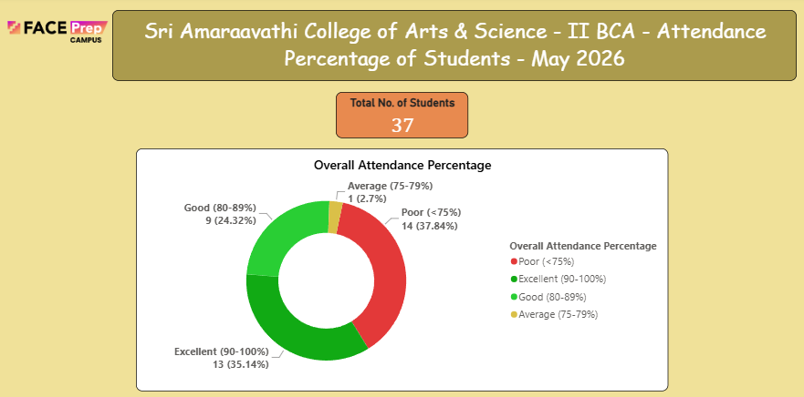
Overall Attendance:
Based on the attendance records, out of a total of 37 students, 23 students have maintained attendance above 75%, which is commendable. Among them, 13 students are in the Excellent category (90-100%), 9 students in the Good category (80-89%), and 1 student in the Average category (75-79%). However, 14 students have recorded attendance below 75% in the Poor category and will require focused monitoring, additional guidance, and appropriate corrective measures to improve their attendance and overall academic participation.
Average: The class recorded an attendance rate of approximately 79%, indicating a moderate level of participation with significant scope for improvement. Continued commitment to regular attendance and targeted interventions for students in the Poor category will help improve overall engagement.

Slide 7
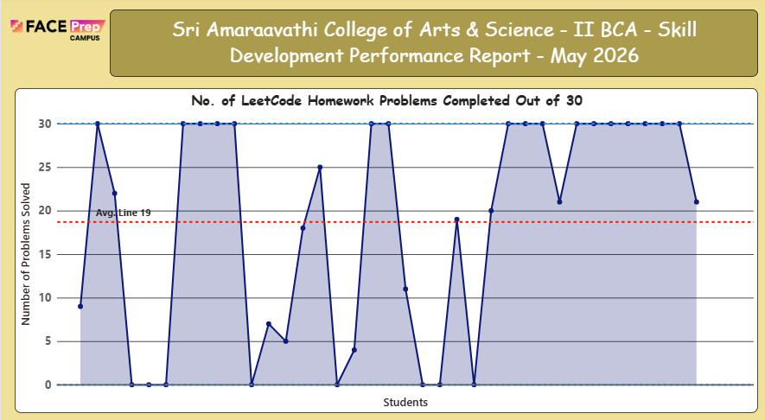
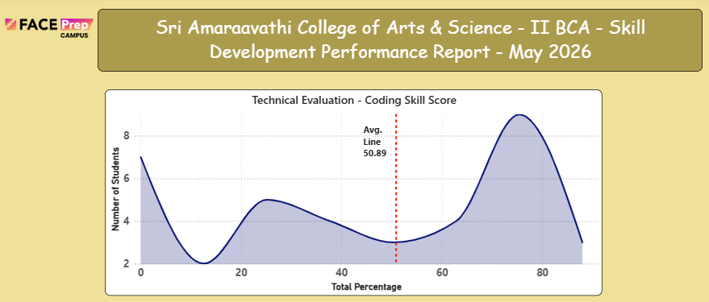
Technical Evaluation
Students underwent rigorous training in coding skills, focusing on solving practical programming problems on the Leet Code platform. A total of 30 homework problems were assigned to enhance their technical proficiency and problem-solving abilities.
On average, students successfully solved 19 out of 30 problems, indicating a moderate to good level of performance. While several students demonstrated strong coding skills by achieving high scores, a few students showed lower participation and consistency, highlighting the need for additional practice and targeted support to improve overall performance.

Slide 8
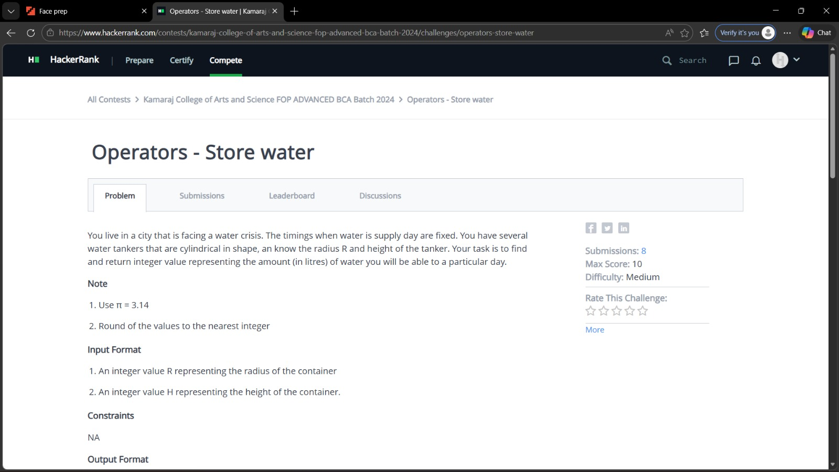
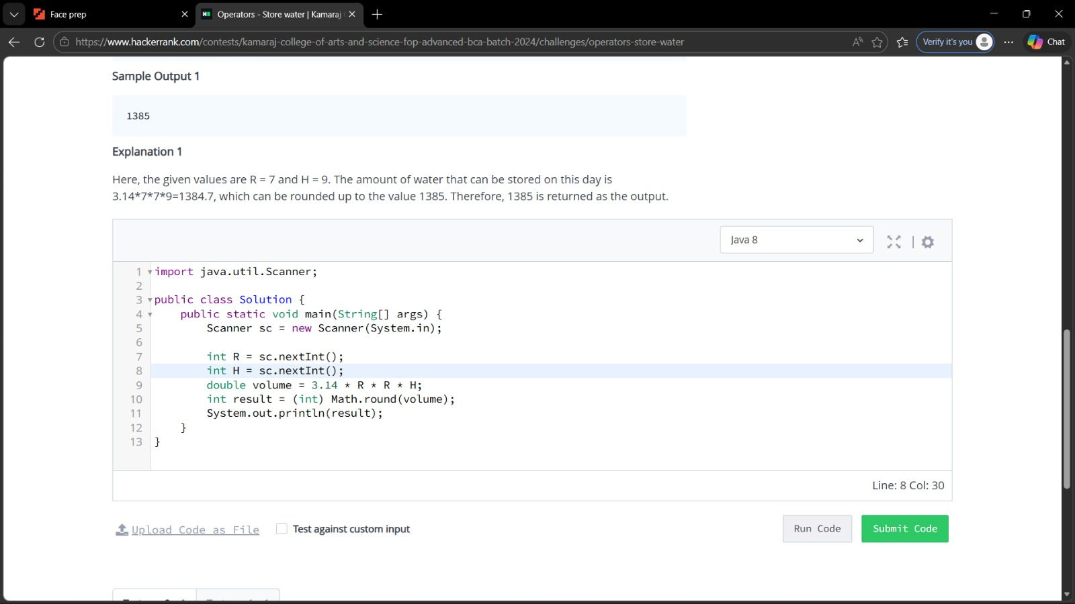
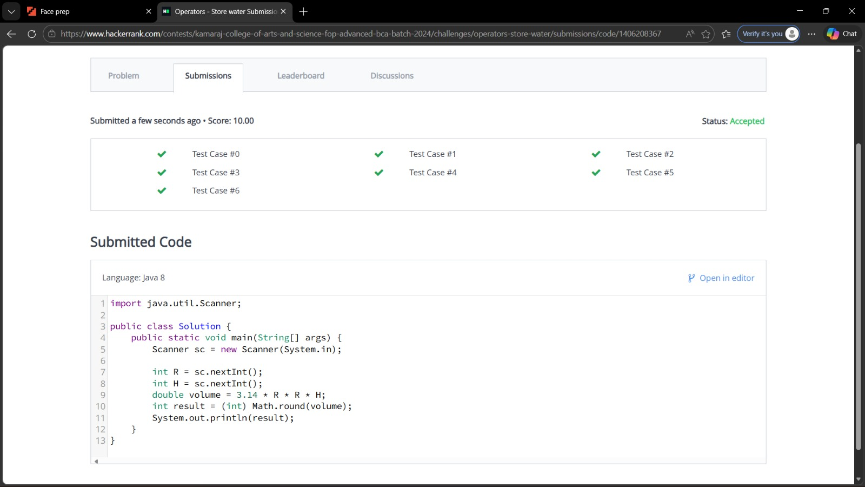
Technical Evaluation
Evaluation: Each student's performance was assessed based on the number of problems solved and the depth of understanding demonstrated. Scores were then converted into percentages to ensure accurate and detailed progress tracking.
Class Average: The class achieved an average score of 50.89%, reflecting a developing level of coding capability with opportunities for further growth.
Profile Building Report
Students focused on enhancing their coding profiles by actively engaging in problem-solving on Leet Code. Each student successfully solved problems on the platform, demonstrating their technical skills and boosting their online presence.

Slide 9
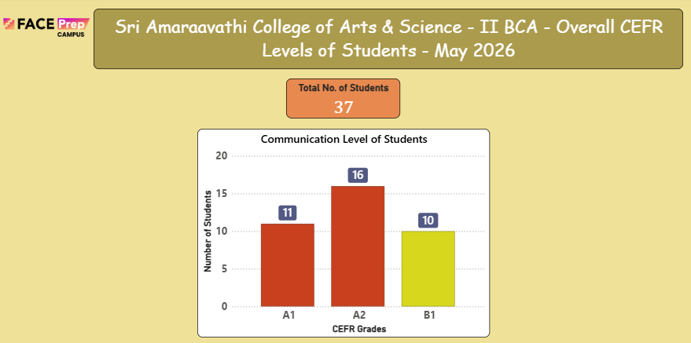
Overall Communication Level
Students underwent focused training in communication skills, emphasizing clarity, confidence, and effectiveness in expression. Various activities and tasks were conducted to strengthen their Writing, Listening, Speaking, Reading, and Presentation abilities.
In the Communication Skills assessment based on CEFR levels, out of 37 students, 11 students are at A1 level (beginner), 16 students are at A2 level (elementary), and 10 students have achieved B1 level (independent user). While the B1 students demonstrate a higher level of communicative competence, the majority of students (27 out of 37) are currently at the foundational stages (A1 and A2) and will require focused monitoring, additional guidance, and appropriate corrective measures to improve their communication proficiency in the forthcoming sessions.
Class Average: The class recorded a majority of students at foundational levels (A1 and A2), indicating a significant need for consistent practice and focused effort to strengthen key communication skills and progress to higher proficiency levels.

Slide 10
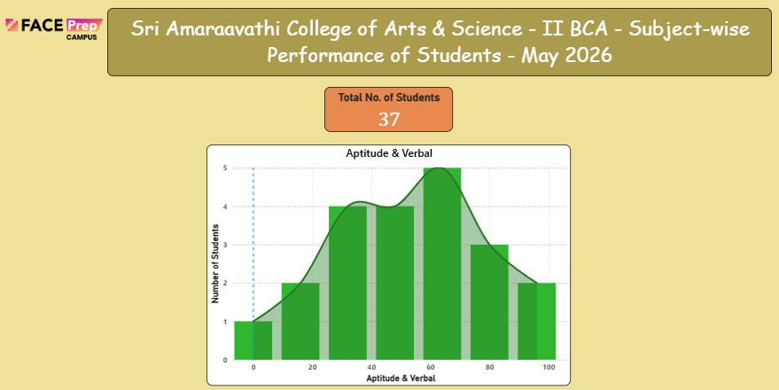
Academic performance
Aptitude & Verbal:
In Aptitude & Verbal, based on the assessments conducted in May 2026, out of 37 students, 32 students attained scores above 60%, which is highly commendable. However, 5 students obtained scores below 60% and will require focused attention, additional support, and targeted interventions to strengthen their logical reasoning, quantitative aptitude, and verbal ability skills to improve their performance in the forthcoming sessions.

Slide 11
I Bachelor of Computer Applications
2025 - 2028
CAMPUS

Slide 12
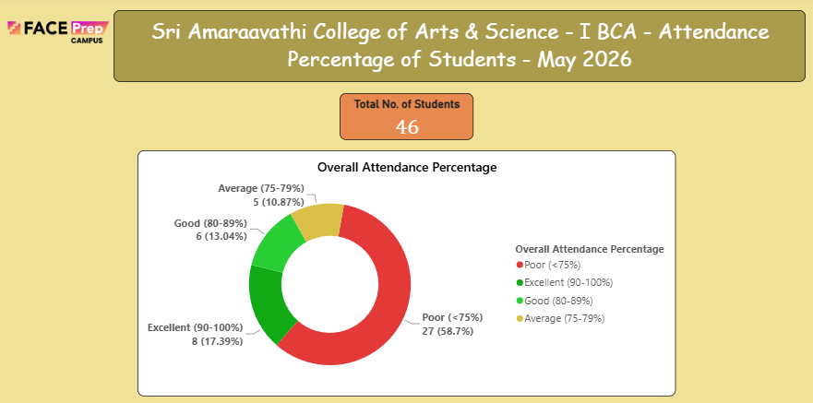
Overall Attendance:
Based on the attendance records, out of a total of 46 students, 8 students have maintained attendance in the Excellent category (90-100%), 6 students in the Good category (80-89%), and 5 students in the Average category (75-79%), which is commendable. However, 27 students have recorded attendance below 75% in the Poor category and will require focused monitoring, additional guidance, and appropriate corrective measures to improve their attendance and overall academic participation.
The class recorded an average attendance rate that requires significant improvement, with 58.7% of students falling in the Poor category. Continued commitment to regular attendance and targeted interventions for students in the Poor category will help improve overall engagement and academic participation.

Slide 13
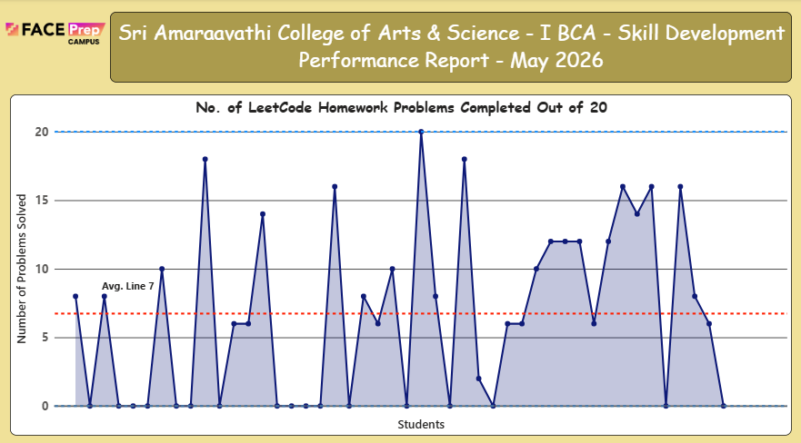
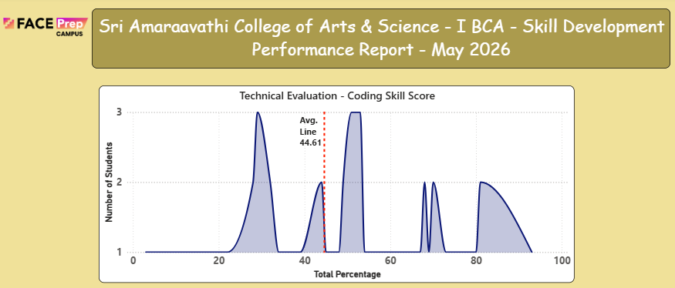
Technical Evaluation
Students underwent rigorous training in coding skills, focusing on solving practical programming problems on the Leet Code platform. A total of 20 homework problems were assigned to enhance their technical proficiency and problem-solving abilities.
On average, students successfully solved 7 out of 20 Leet Code problems, indicating a moderate level of performance with significant room for improvement. While several students demonstrated strong coding skills by achieving high scores, a few students showed lower participation and consistency, highlighting the need for additional practice and targeted support to improve overall performance.

Slide 14
Technical Evaluation
Evaluation: Each student's performance was assessed based on the number of problems solved and the depth of understanding demonstrated. Scores were then converted into percentages to ensure accurate and detailed progress tracking.
Class Average: The class achieved an average score of 44.61%, reflecting a developing level of coding capability with significant room for growth.
Profile Building Report
Students focused on enhancing their coding profiles by actively engaging in problem-solving on Leet Code. Each student successfully solved problems on the platform, demonstrating their technical skills and boosting their online presence.

Slide 15
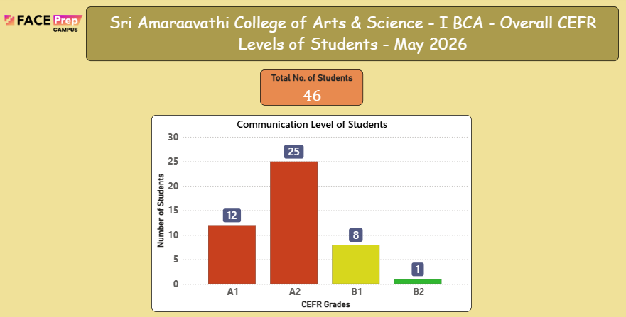
Overall Communication Level
Students underwent focused training in communication skills, emphasizing clarity, confidence, and effectiveness in expression. Various activities and tasks were conducted to strengthen their Writing, Listening, Speaking, Reading, and Presentation abilities.
In the Communication Skills assessment based on CEFR levels, out of 46 students, 12 students are at A1 level, 25 students are at A2 level, 8 students have achieved B1 level, and 1 student has achieved B2 level. While the B1 and B2 students demonstrate higher levels of communicative competence, the majority of students (37 out of 46) are currently at the foundational stages (A1 and A2) and will require focused monitoring, additional guidance, and appropriate corrective measures to improve their communication proficiency in the forthcoming sessions.
Class Average: The class achieved a mix of foundational and intermediate levels, with a majority at A1 and A2, indicating the need for consistent practice, targeted support, and focused effort to strengthen key communication skills and progress to higher proficiency levels.

Slide 16
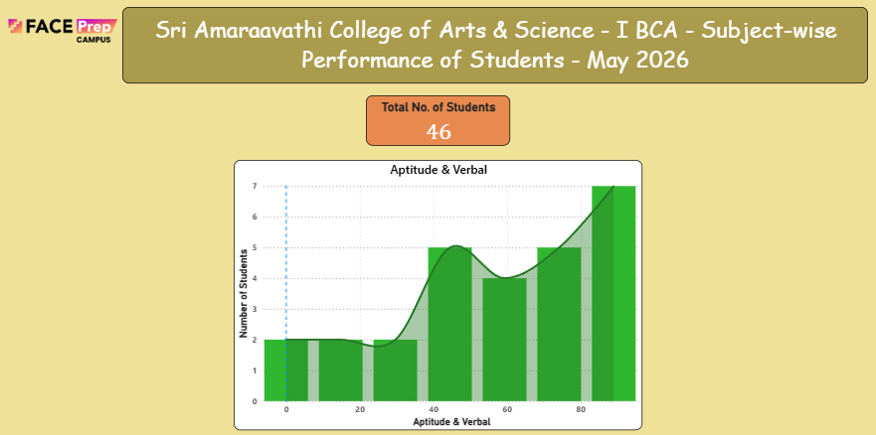
Academic performance
Aptitude & Verbal:
In Aptitude & Verbal, based on the assessments conducted in May 2026, out of 46 students, the performance distribution across percentage brackets shows that the majority of students scored in the lower ranges (0–40%). Only a few students managed to score above 60%, indicating a widespread and critical need for improvement across the class. Students struggled significantly with logical reasoning, numerical ability, time management, reading comprehension, grammar, and vocabulary. Key contributing factors include irregular practice, limited reading exposure, lack of test-taking strategies, and low confidence in attempting unfamiliar question types. Therefore, most students require focused interventions such as weekly quizzes, remedial sessions, daily practice worksheets, peer-assisted learning, and biweekly mock tests to strengthen their aptitude and verbal reasoning skills in the forthcoming sessions.

Slide 17
I Bachelor of Science (Artificial Intelligence and Machine Learning)
2025 - 2028
CAMPUS

Slide 18
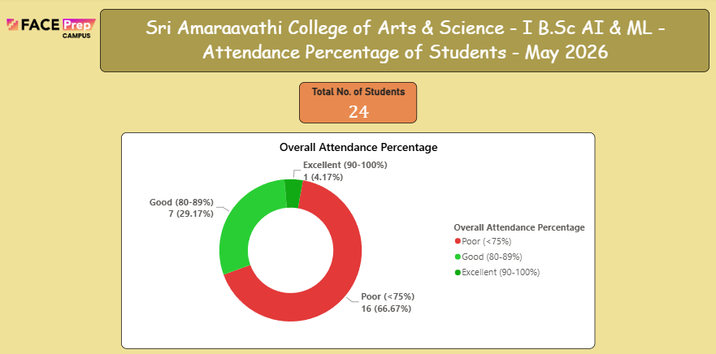
Overall Attendance:
Based on the attendance records, out of a total of 24 students, only 1 student (4.17%) has maintained attendance in the Excellent category (90-100%) and 7 students (29.17%) in the Good category (80-89%). This indicates a significant decline in attendance compared to previous months. However, 16 students (66.67%) have recorded attendance below 75% in the Poor category, which is a serious area of concern. These students will require focused monitoring, additional guidance, and appropriate corrective measures to improve their attendance and overall academic participation.
Average: The class recorded a poor attendance rate, with the majority of students (66.67%) falling in the Poor category. Immediate interventions, regular counselling, and parent-teacher meetings are recommended to address this declining trend and improve overall engagement.

Slide 19
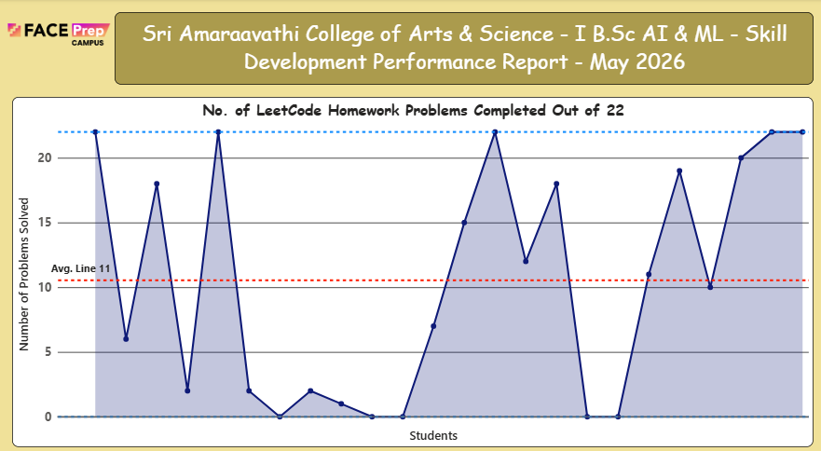
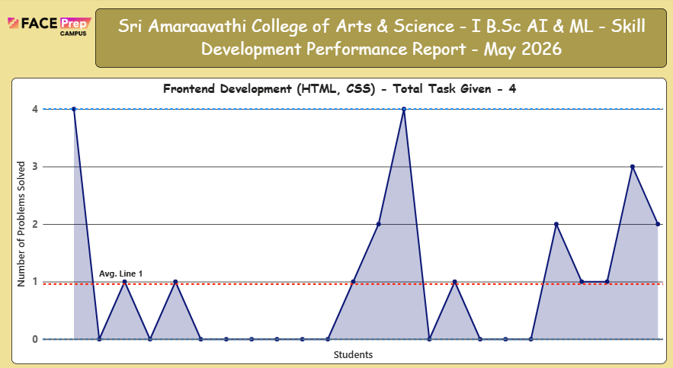
Technical Evaluation
Students underwent rigorous training in coding skills using OOP Java, Frontend Development (HTML, CSS), and Leet Code, focusing on solving real-world problems. A total of 22 Leet Code homework problems were assigned, along with 4 Frontend Development tasks, to enhance their technical proficiency and problem-solving abilities.
On average, students successfully solved 11 out of 22 Leet Code problems and completed 1 out of 4 Frontend Development tasks, indicating a moderate level of performance with significant room for improvement. While several students demonstrated strong coding skills by achieving high scores, a few students showed lower participation and consistency, highlighting the need for additional practice and targeted support to improve overall performance.

Slide 20
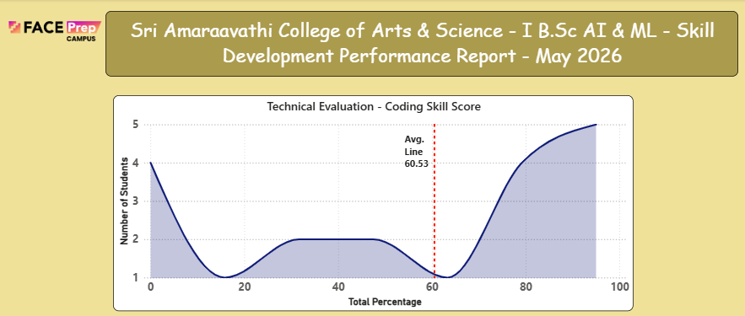
Technical Evaluation
Evaluation: Each student's performance was assessed based on the number of problems solved, tasks completed, and the depth of understanding demonstrated. Scores were then converted into percentages to ensure accurate and detailed progress tracking.
Class Average: The class achieved an average score of 60.53%, reflecting a developing level of coding capability with opportunities for further growth.
Profile Building Report
Students focused on enhancing their coding profiles by actively engaging in problem-solving on Leet Code and building practical frontend development skills using HTML and CSS. Each student successfully solved problems and completed tasks across both areas, demonstrating their technical skills and boosting their online presence.

Slide 21
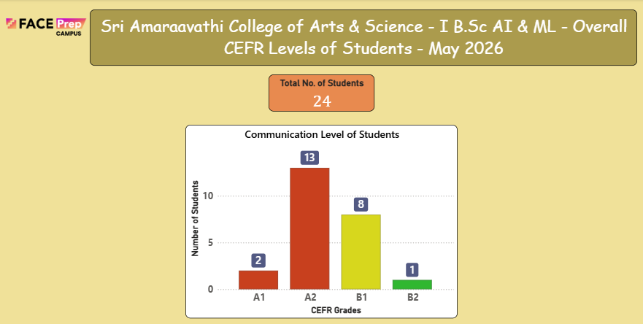
Overall Communication Level
Students underwent focused training in communication skills, emphasizing clarity, confidence, and effectiveness in expression. Various activities and tasks were conducted to strengthen their Writing, Listening, Speaking, Reading, and Presentation abilities.
Based on the CEFR assessment, out of a total of 24 students, 2 students are at A1 level, 13 students are at A2 level, 8 students have achieved B1 level, and 1 student has achieved B2 level. While the B1 and B2 students demonstrate higher levels of communicative competence, the majority of students (15 out of 24) are currently at the foundational stages (A1 and A2) and will require focused monitoring, additional guidance, and appropriate corrective measures to improve their communication proficiency in the forthcoming sessions.
Class Average: The class recorded a mix of foundational and intermediate levels, with a majority at A2 level, indicating steady progress while also highlighting the need for consistent practice and focused effort to strengthen key communication skills across all domains.

Slide 22
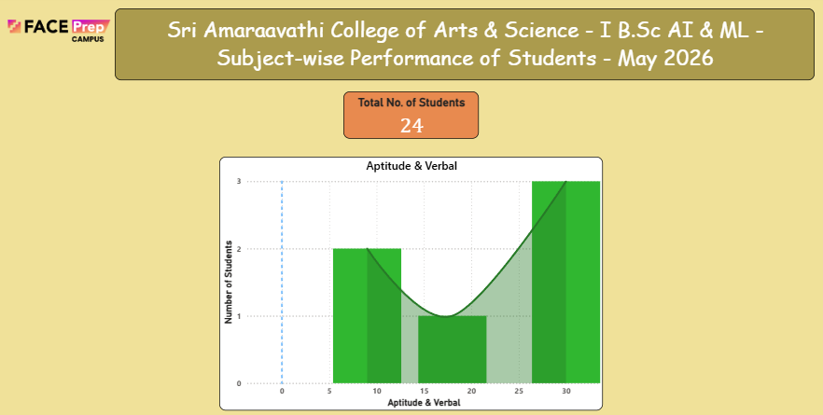
Academic performance
Aptitude & Verbal:
In Aptitude & Verbal, based on the assessments conducted in May 2026, out of a total of 24 students, the performance distribution across percentage brackets shows that the majority of students scored in the lower ranges (0–40%). Only a few students managed to score above 60%, indicating a significant need for improvement across the class. Students struggled with logical reasoning, numerical ability, time management, reading comprehension, grammar, and vocabulary. Therefore, most students require focused interventions such as weekly quizzes, remedial sessions, daily practice worksheets, peer-assisted learning, and biweekly mock tests to strengthen their aptitude and verbal reasoning skills in the forthcoming sessions.

Slide 23
I Bachelor of Commerce (Fin Tech)
2025 - 2028
CAMPUS

Slide 24
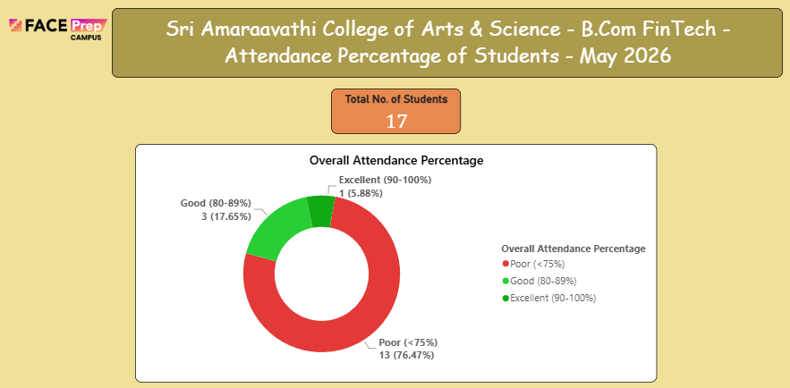
Overall Attendance:
Based on the attendance records, out of a total of 17 students, 1 student has maintained attendance in the Excellent category (90-100%) and 3 students in the Good category (80-89%), which is commendable. However, the remaining students have recorded attendance below 75% in the Poor category and will require focused monitoring, additional guidance, and appropriate corrective measures to improve their attendance and overall academic participation.
Average: The class recorded an attendance distribution showing 1 student in Excellent (5.88%), 3 students in Good (17.65%), and the remaining students in the Poor category. Continued commitment to regular attendance and targeted interventions for students in the Poor category will help improve overall engagement.

Slide 25
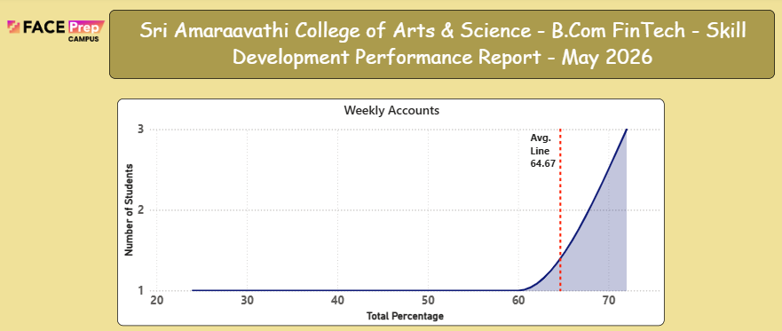
Technical Evaluation
Students were assigned SEBI Case Study, SEBI Certification, Tally Vouchers & EDA to enhance their practical and industry-relevant skills. A total of 17 students participated in the assessments.
Performance Distribution: Based on the assessment scores distributed across percentage brackets ranging from 20% to 70%, the class achieved an average score of 64.67%. The distribution shows that students are spread across various performance levels.

Slide 26
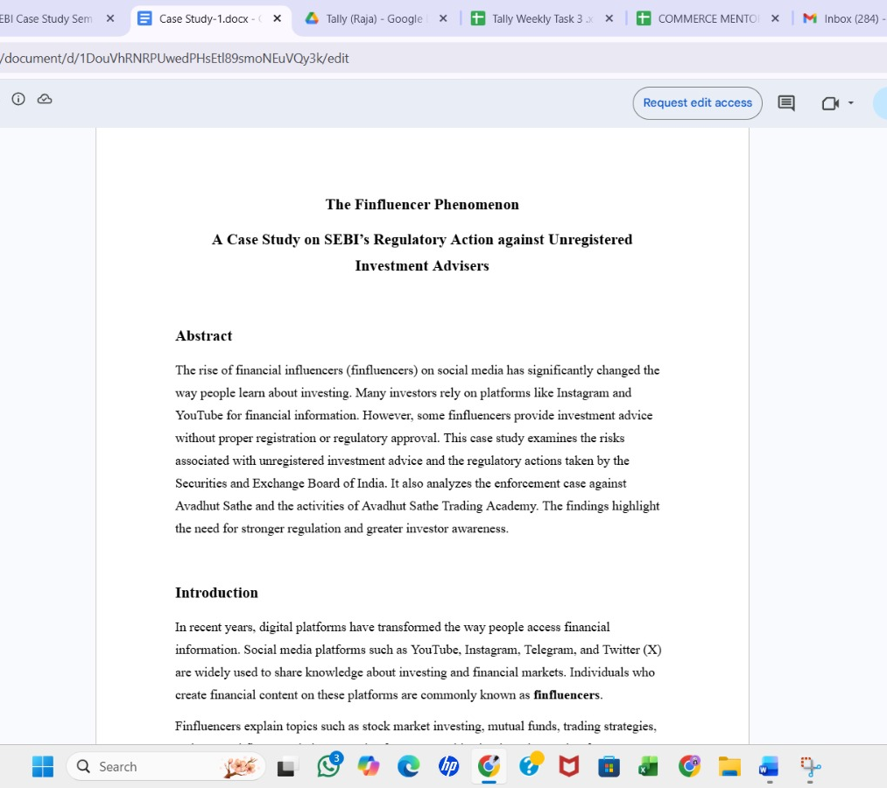
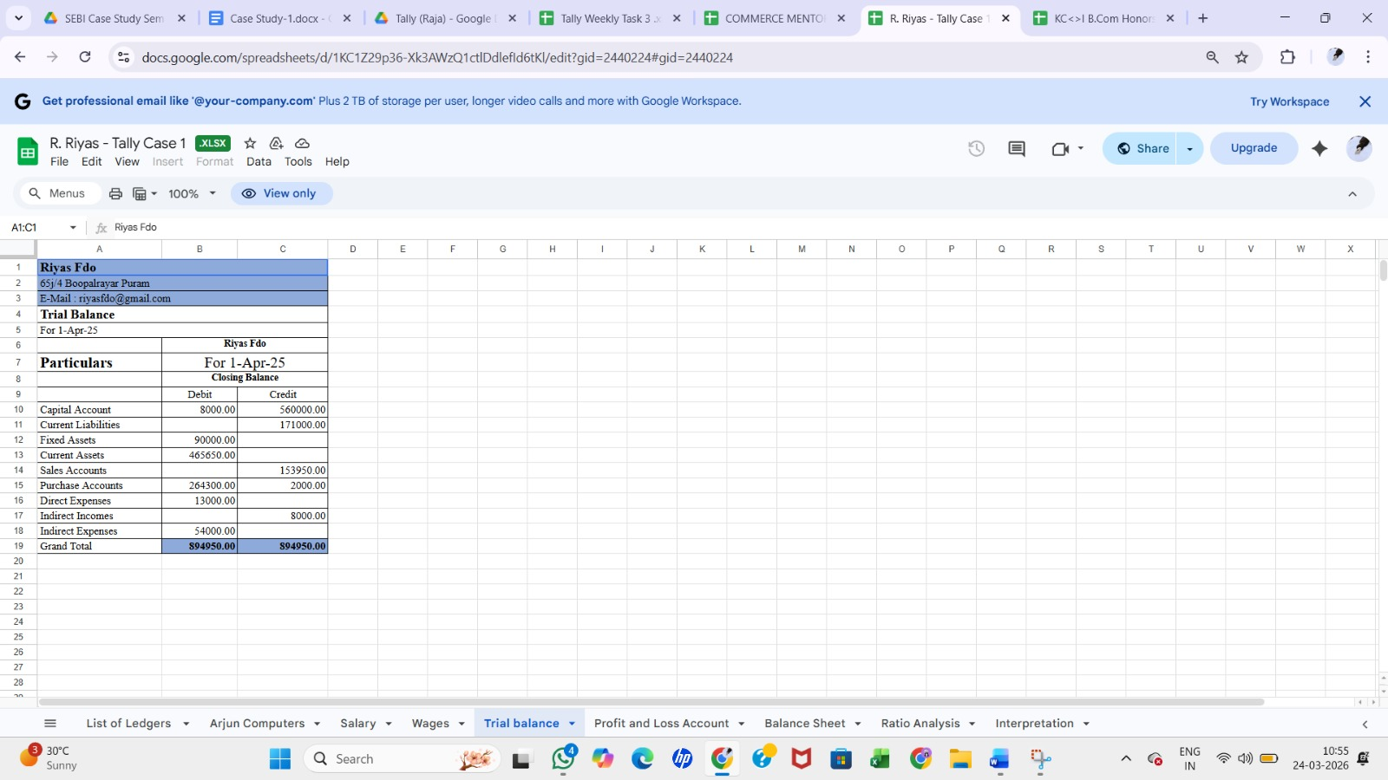
Technical Evaluation
Class Performance: Out of a total of 17 students, the majority secured scores above 60%, reflecting their proficiency and consistent effort. However, some students scored below 60% and will require focused attention, additional support, and targeted interventions. These students show potential and can perform well with additional guidance and support to strengthen their practical knowledge and improve their performance in the forthcoming sessions.
Evaluation: Each student's performance was assessed based on the presentation and financial report evaluation. Scores were then converted into percentages to ensure accurate and detailed progress tracking.
Class Average: The class achieved an average score of 64.67%, reflecting a developing level of performance with opportunities for further growth.

Slide 27
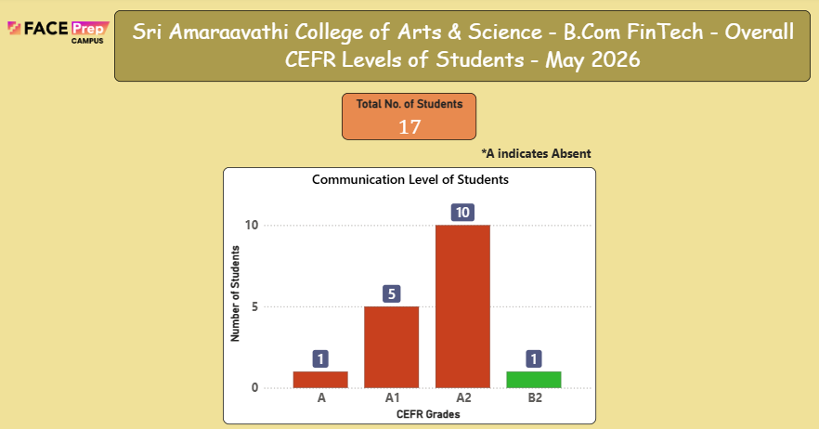
Overall Communication Level
Students underwent focused training in communication skills, emphasizing clarity, confidence, and effectiveness in expression. Various activities and tasks were conducted to strengthen their Writing, Listening, Speaking, Reading, and Presentation abilities.
In the Communication Skills assessment based on CEFR levels, out of 17 students, 1 student was absent (A), 5 students are at A1 level, 10 students are at A2 level, and 1 student has achieved B2 level. The majority of students (15 out of 17) are currently at foundational stages (A1 and A2), with only one student reaching B2 level. An action plan will be implemented to provide focused interventions to improve communication proficiency in the forthcoming sessions.
Class Average: The class recorded a majority of students at foundational levels (A1 and A2), indicating the need for consistent practice, targeted support, and focused effort to strengthen key communication skills and progress to higher proficiency levels.

Slide 28
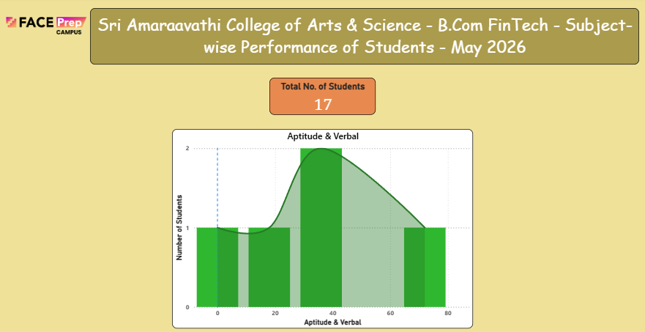
Academic performance
Aptitude & Verbal:
In Aptitude & Verbal, based on the assessments conducted in May 2026, out of a total of 17 students, the performance distribution across percentage brackets shows that the majority of students scored in the lower ranges (0–40%). Only a few students managed to score above 60%, indicating a significant need for improvement across the class. Students struggled with logical reasoning, numerical ability, time management, reading comprehension, grammar, and vocabulary. Therefore, most students require focused interventions such as weekly quizzes, remedial sessions, daily practice worksheets, peer-assisted learning, and biweekly mock tests to strengthen their aptitude and verbal reasoning skills in the forthcoming sessions

Slide 29
May Month Highlights:
1. Build-to-Learn Summer Internship Program 2026 – Strong Progress
The Build-to-Learn Summer Internship Program 2026 continues to gain momentum across Computer Science, AIML, BBA, and B. Com streams.
Out of the 75+ students registered, 34 students have successfully completed their projects and submitted their final deliverables.
The remaining students are actively working on their projects and are progressing through the development and refinement stages.
Students are building real-world solutions for local businesses, including inventory management systems, customer feedback platforms, expense tracking tools, and sales prediction models.
Regular mentor interactions and weekly reviews are helping students stay on track and achieve project milestones.
2. 1M1B Internship Program – Excellent Student Participation
The institution successfully facilitated registrations for the 1M1B Internship Program, providing students with valuable industry exposure and skill development opportunities.
92 students registered for the internship program.
75 students received their official offer letters and enrolled in the internship.
Students have been actively participating in the training and learning sessions.
As of May, 9 internship sessions have been successfully completed, with consistent student attendance and engagement.
The program continues to enhance students’ professional skills, industry awareness, and career readiness.

Slide 30

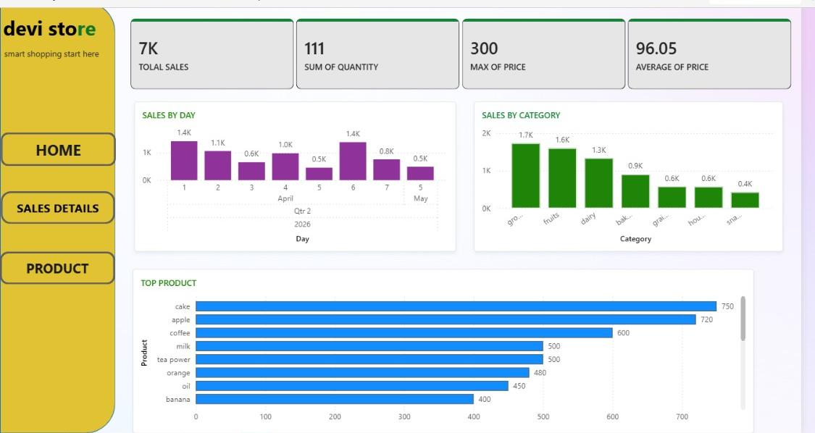
May Month Highlights:
3. HIRE Assessment Conducted to Evaluate Placement Readiness
To assess students' placement preparedness and identify their strengths and improvement areas, the HIRE Assessment was conducted on 20th May 2026.
The assessment was designed in three stages:
I)Aptitude Assessment
II)Programming/Technical Assessment (DSA)
III)Placement Readiness Evaluation
Key Outcomes:
Students demonstrated strong participation and enthusiasm throughout the assessment process.
Overall performance was encouraging, indicating a positive level of placement readiness among participants.
The assessment results will help mentors and placement teams provide targeted support and training to further improve student outcomes.
Looking Ahead
Completion of the remaining Build-to-Learn internship projects.
Continued engagement in the 1M1B Internship Program and upcoming learning sessions.
Focused training interventions based on HIRE Assessment performance to strengthen placement readiness and career opportunities for students.

Slide 31
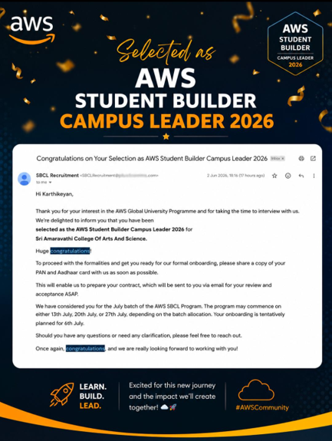
Student Acheivements:
AWS Student Builder Campus Leader 2026
We are delighted to share that Mr. Karthikeyan V, a II Year B.Sc. Artificial Intelligence & Machine Learning (AIML) student, has been selected as an AWS Student Builder Campus Leader 2026 under the AWS Global University Programme.
Achievement Highlights:
Successfully cleared the AWS selection and interview process.
Selected as an AWS Student Builder Campus Leader 2026, representing our institution at the national and global student community level.
Will lead and promote cloud computing awareness, technical learning initiatives, workshops, and student engagement activities on campus.
Will gain access to AWS learning resources, mentorship opportunities, leadership training, and networking platforms.
This achievement reflects his technical expertise, leadership potential, and commitment to continuous learning.
We congratulate Mr. Karthikeyan V on this remarkable accomplishment and wish him continued success in his journey as an AWS Campus Leader.

Slide 32
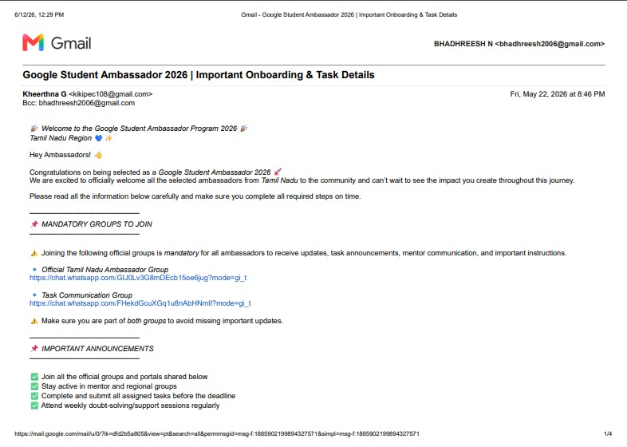
Student Acheivements:
Google Student Ambassador 2026 Selection
We are proud to announce that Mr. N. Bhadhreesh and Ms. Dhasanya M, students of III Year BCA, have been selected as Google Student Ambassadors 2026.
Achievement Highlights:
Successfully completed the selection process and secured a place in the Google Student Ambassador Program 2026.
Selected to represent their institution as part of the Tamil Nadu Student Ambassador community.
Will actively participate in technology-focused initiatives, community engagement activities, peer learning programs, and digital skill development campaigns.
Will receive opportunities to collaborate with fellow student leaders, attend mentoring sessions, and contribute to promoting Google's learning ecosystem among students.
Their selection reflects their leadership qualities, communication skills, technical interest, and commitment to student community development.

Slide 33

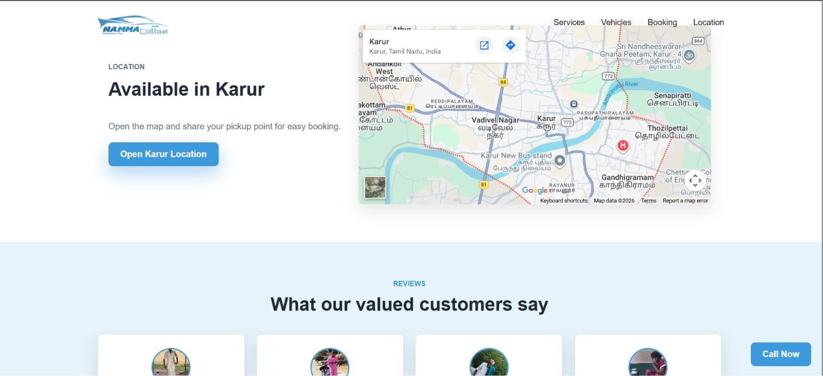
Student Project Acheivements:

Slide 34
Thank You

